Slide 1
S-100 Validation Tests sub group
5th VTC Meeting
23rd October 2023

Slide 2
Meeting protocol
Meeting participants are kindly requested to note the following meeting protocols;
Please keep your camera and microphone turned “off” if you are not talking or presenting
If you want to make an intervention, please turn your camera and microphone on and, raise your hand to indicate that you wish to speak
Don’t forget to turn your microphone “on” before speaking, and “off” when finished
Please use the “Chat” function to communicate an text information to the meeting
If you have any problems connecting using Firefox or other browser – please try using Chrome.

Slide 3
AGENDA
S-101 PT
Actions affecting S-100 Validation group
Side meeting
Summary of papers submitted to S-100 WG
8.1 Cross Validation Checks
8.2 Standardised naming convention and structure for Product Specifications
Initial tests Part1, Part 2, Part 4b, Part 5, Part 6, Part 7(not finished), Part 10c, Part 17
Issues raised
Status on tasks
Next meetings

Slide 4
S-101 Pt meeting – actions affecting s-100 validation
S-100 Validation will take over maintenance for Part 1 of S-101 Validation proposed S-100 checks
Primarily 10a checks but others as well
Will just insert checks onto list
May need to raise wording to S-100 level (written with ENCs in mind)
Need to review 10a as to whether any other checks outstanding
Will allocate numbers 153-316
Need S-100 Part reference
Frank has reviewed and appears to be little duplication
S-100 Validation sub-group to initiate a task for sub-group to determine a standard structure for Validation Checks to be implemented across all S-100 based Product Specifications
S-101 PT recommended that S-100 Validation Checks should be included as an Annex to S-98

Slide 5
S-100 Validation Meeting 4 (Side bar to S-101 PT)
Discussion over progress to date and explaining process of reviewing Parts
Were pleased that we were focusing from S-100 perspective and not from a Product Specification point of view.
There are quite few parts remaining but stated prioritising 15, 16, 18, 10 a, b & c and 9
Discussed the different types of S-100 Validation
Cross-product Validation - this has come up at S-98/S-164 meetings as well
Frank & Mikus volunteered to write tests for some parts.
PowerPoint Presentation (iho.int)
Will be uploaded to the S-100 Validation IHO webpage

Slide 6
Papers to S-100wg 8
8.1 S-100 Validation Tests and Cross-Product Validation
Joint paper submitted by me and Jonathan (S-98/S-164 lead) https://portal.iho.int/share/files/491
Key points:
What is S-100 Validation?
What is meant by validation?
The dataset itself is valid according to the Product Specification Validation Tests
The dataset is valid against datasets of the same product type (e.g. S-101 vs S-101)
S-100 level Validation Tests (apply to all datasets e.g. Feature Catalogue against Portrayal Catalogue, if a Portrayal Catalogue is present).
Tests of individual S-100 components themselves (e.g. whether feature/portrayal catalogues are consistent with each other and conform to the S-100 schemas)
Additionally, there is another type of validation that has not been catered for here, which is whether a dataset is “valid” (or compatible with) another dataset of a different type e.g. S-101 vs S-102, a form of cross-product validation.
Action Required of S-100 WG:
Endorse the different types of validation required for S-100

Slide 7
Papers to s-100wg 8 cont.
Cross-Product Validation
Certain product datasets are designed to be interoperable (WLA) and they need to be safe to use together
Currently can have S-101 and an S-102 dataset that both pass S-100 validation and their own PS validation but could contain content that could provide misleading or dangerous information.
ECDIS cannot perform a content check and have no way to know which datasets are safe for interoperable use.
Proposal is to produced a sets of validation tests, initially focusing on WLA and user selected safety contours to provide guidance to the producing agencies (possibly RENCs) on when datasets can be considered safe for distribution for interoperable use on an ECDIS.
If there are additional datasets intended for used on ECDIS but not for interoperable use then a mechanism needs to be developed to identify them
Proposal for S-164/S-98 and S-100 Validation sub groups to work on this in collaboration with Product Specification owners
Action Required of S-100 WG:
Invite the S-100 Validation subgroup to liaise with the S-98/S-164 subgroup and DQWG to clarify the definitions and scope of the different validation tests.
Endorse the drafting of an appendix to S-98 to contain Cross-Product Validation Tests
Task the S-98/S-164 & S-100 Validation Sub Groups to complete initial content of these tests by working with the relevant Product Specification project teams.

Slide 8
Papers to S-100wg 8 Cont.
8.2 Standardised naming convention and structure for S-100 PS
Submitted by me on behalf of S-100 Validation group 493 (iho.int)
Key points:
13 different PS and S-100 Validation tests but there are numerous styles of naming conventions and structure of tests (S-100, NIPWG, TWCWG, WWNWS, IALA)
Discussion topics:
Is this a problem? Could be confusing when we have tests with the same name, especially when data producers are making multiple products.
Is there a need for a standardised structure?
Should this be for all PS or limited to WG or Domains?
Are there PS that have special requirements for tests that others don’t?
Action Required of S-100 WG:
Endorse the standardisation of a naming convention with the use of the Product Specification number at the front of the check and the use of only numerical Check IDs
Invite the S-100 Validation sub group to liaise with the Product Specification sub groups & Project Teams to agree a standardised structure to the validation tests
Agree how widespread the standardisation is required, whether limited to:Working Groups & Project Teams, IHO Domain or all S-100 Product Specifications
Endorse the updating of S-97 to include guidance on standardised naming convention and check structure, if endorsed above

Slide 9
Status on parts review
Initial tests Part1, Part 2, Part 4b, Part 5, Part 6, Part 7(not finished), Part 8, Part 10c, Part 17
Parts 15 (Data Protection Scheme) & 16 (Interoperability Catalogue Model) allocated
Prioritised list remaining
18 (Language Packs)
10b (GML Encoding)
9 (Portrayal)

Slide 10
ISSUES
Open Issues
Issue 14 (Invalid Geometries) Invalid geometries · Issue #14 · iho-ohi/S-100-Validation-Checks · GitHub
Issue 9 (Part 17 checks) – amended wording for items 1, 2 & 4. Item 3 TBD at S-100WG8. Item 5, need S-100 Part Reference link.
Issue 10 (Checks for organization and individual information in CATALOG.XML) – not completed yet
Issue 11 (Proposed checks for locale consistency between resource and discovery metadata block) – paper submitted to S-100 WG8. Review after meeting. http://iho-portal.bluemap.kr/share/files/387
Issue 7 (use of “unknown” for feature attribute binding) - closed
Issue 13 (Input on proposed checks relating to HDF5-format products) – following S-100 WG8 will review, likely moved to Cross-Product Validation
Issue 6 (naming convention) – temporarily on hold with decision on Dev ID. Will review after S-100 WG8
https://github.com/iho-ohi/S-100-Validation-Checks/issues

Slide 11
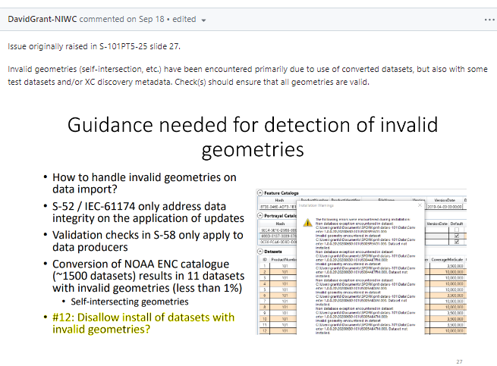
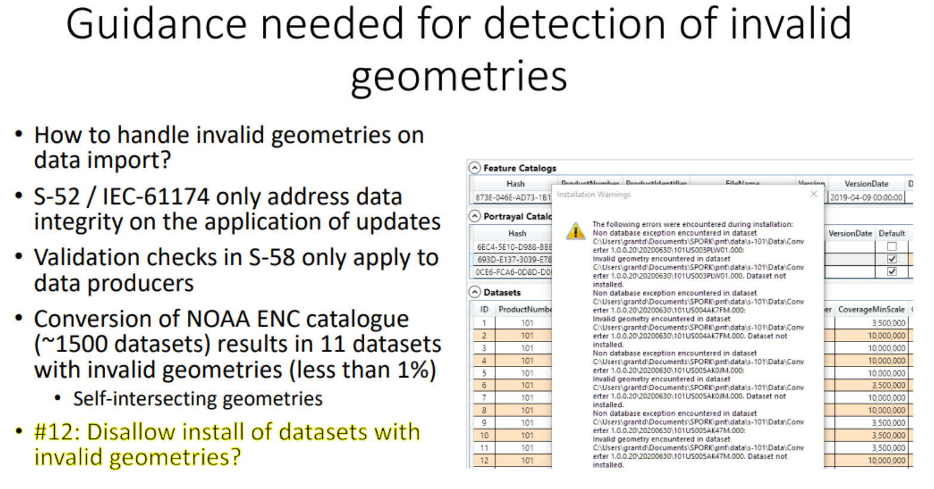
Issue 14 invalid geometries

Slide 12
Next steps
Continue producing a set of tests from Parts of S-100 & incorporate other tests (S-101, IIC etc.)
Tabulate and place on GitHub
Then group to comment and raise issues using Check ID in title
204 tests written from Part1, Part 2, Part 4b, Part 5, Part 6, Part 7 (not finished), Part 10c, Part 17
164 from S-101 Proposed tests (368 in total)
Categorisation of tests – not discussed yet, potentially Part name rather than number
Will raise in report of group back to S-100WG 8
Interfaces with DQWG - need to progress
Naming conventions across different validation tests – paper in to S-100 WG8
Document write up with an initial explanation of ‘what is S-100 level validation’ - paper in to S-100 WG8
If agreed at S-100 WG8, coordinate Cross-Product Validation with S-98/S-164 lead
Draft proposal for standardised validation test structure across all Product Specifications (if agreed at S-100 WG8)

Slide 13
Deliverable – OCT 2023
Initial list of high level checks
Can be expanded upon afterwards
Version 2 of S-100 validation has been uploaded, newer version will be uploaded ahead of meeting
Document write up with an initial explanation of ‘what is S-100 level validation’
Submitted paper with definitions of S-100 validation and looking for agreement at S-100WG 8

Slide 14
Next meetings
November S-100 WG 8 meeting – Singapore 13-17th November
Suggest next meeting is then end January ahead of next S-101 PT meeting
Monday 22nd January or 29th January

Slide 15
Any Questions?

